Slide 2
The World Conference on Constitutional Justice unites 100 constitutional justice institutions from Africa, the Americas, Australia, Asia, and Europe.
The objective – to promote constitutional justice – understood as constitutional review including human rights case-law – as a key element for democracy, the protection human rights and the rule of law.
In pursuit of this objective, the World Conference organizes regular congresses uniting all members on a global scale.

Slide 3
1st Congress – Cape Town, the Republic of South Africa, on 22–24 January 2009.
Topic: “Influential Constitutional Justice – its influence on the society and on developing a global jurisprudence on human rights”.
2nd Congress – Rio de Janeiro, Brazil, on 16–18 January 2011.
Topic: “Separation of Powers and Independence of Constitutional Courts and Equivalent Bodies”.
3rd Congress – Seoul, Korea, on 28 September–1 October 2014.
Topic: “Constitutional Justice and Social Integration”.

Slide 4
In March 2015, the Bureau of the World Conference on Constitutional Justice accepted the offer from the Constitutional Court of Lithuania to host the 4th Congress of the World Conference on Constitutional Justice in the capital of Lithuania – Vilnius – in 2017.

Slide 5
Situated at the crossroads between Eastern and Western Europe, Lithuania is a modern and forward-looking member state of the European Union and NATO with its thousand-year history.
The independence of Lithuania was restored in 1990 after half a century of Soviet occupation.
For centuries it resisted those who encroached on its freedom, and has preserved its spirit, native language, writing, and customs.
Strong tradition of tolerance and pluralism and is home to fellow citizens of many nationalities and faiths.

Slide 6
Lithuania at a glance
• currently among the fastest-growing countries in the European Union (World Economic Forum, 2016)
• ranked among top 10 global investment locations (IBM Global Location Trends report, 2016)
• 1st in the European Union in terms of population (93 %) with higher or secondary education (Eurostat,2015)
• has the highest ratio of young people in Central and Eastern Europe (Eurostat, 2015)
• ranked 13th freest economy in the world (Heritage Foundation, Economic Freedom Index, 2016)

Slide 7
Lithuania - biggest in the Baltics
Population: 2.86 million (Latvia –1.95 million, Estonia – 1.31 million).
Geographical location: the Republic of Lithuania lies on the eastern coast of the Baltic Sea.
Official language: Lithuanian.
Currency: Euro.
Nature: 34 percent of Lithuania’s territory is covered by forests; 2 585 is the number of lakes larger than 0.5 hectares.
Climate: maritime/continental.

Slide 8
Despite its modest size, Lithuania is rich in heritage that the world believes to be rare and valuable.
The magnificently beautiful historic centre of its capital Vilnius is included in the UNESCO World Heritage List, as well as Kernavė archaeological site – an ensemble with archaeological elements, including a unique complex of impressive hill forts, the Curonian Spit – the narrow and lengthy forested peninsula with its largest drifting sand dunes in Europe, and the legendary Hill of Crosses with more than 200 000 crosses, surrounded by mysterious aura.

Slide 9
Vilnius – capital city where centuries meet
Vilnius is a European city with unique spirit that perfectly combines the comforts of the modern world and charming historical heritage.
Largest Baroque old town in Eastern and Central Europe
One of the greenest capitals in Europe, with its 40-percent coverage of vegetation
Proud of its clean water – tap water may be enjoyed without hesitation

Slide 10
The Host Court
Established in 1993
First in Europe to host the World Congress
Active participation in international communities – the Conference of European Constitutional Courts (since 1997) and one of the founding members of the World Conference on Constitutional Justice (idea to establish - raised during the XIVth Congress of the Conference of European Constitutional Courts, which took place in Vilnius in 2008)
The CC of Lithuania is also one of the founding members of the Association of Constitutional Justice of the Countries of the Baltic and Black Sea Regions (2015)

Slide 11
About the Congress
On 11–14 September 2017 in Vilnius,
the 4th Congress will bring together representatives of constitutional courts, supreme constitutional justice institutions, international courts, and organizations from around the world.
The Congress will be held in the year of special significance to the Lithuanian state: in 2017, Lithuania will mark the 25th anniversary of the Constitution of the Republic of Lithuania, which has remained longest in force throughout the history of the modern State of Lithuania.

Slide 12
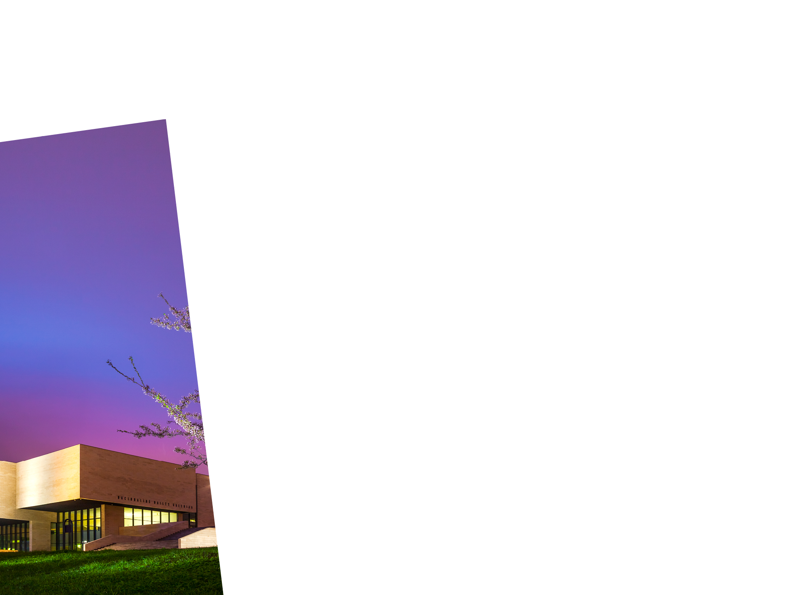
The Venue
The 4th Congress will take place in the National Gallery of Art. It is a modern multifunctional centre of art and culture that offers an inspirational environment and is located in the centre of Vilnius. The National Gallery of Art has provided the venue for a number of events of both national and international importance.

Slide 13
In March 2016, the Bureau:
Adopted the topic
Approved the dates
Approved the logo
Authorized the preparation of the concept paper and the questionnaire
Invited the groups to make up to 3 proposals for key-note speakers, moderators and rapporteurs
Approved the distribution of costs
Decided on the size of delegations
Decided on other important issues (e.g. interventions, meetings of groups)

Slide 14
The Rule of Law and Constitutional Justice in the Contemporary World
The topic of the 4th Congress has been chosen bearing in mind that the rule of law is a prominent multifaceted and uniquely structured constitutional principle, which constitutes the cornerstone of every legal system in the modern world.
Therefore, a permanent dialogue on the rule of law and on the implementation of this principle contributes to the strengthening of common constitutional values throughout the world.
The topic is of particular interest to the Central and Eastern European region, which, as a result of the oppression and occupation it experienced for half of a century, was devoid of the existence of the rule of law and constitutional justice.

Slide 15
The Rule of Law and Constitutional Justice in the Contemporary World
The participants of the event will be invited to discuss the main topic of the 4th Congress, subdivided as follows:
- the different concepts of the rule of law
- new challenges to the rule of law
- the law and the state
- the law and the individual
The participants will also take part in the stocktaking session on the independence of the constitutional courts.

Slide 16
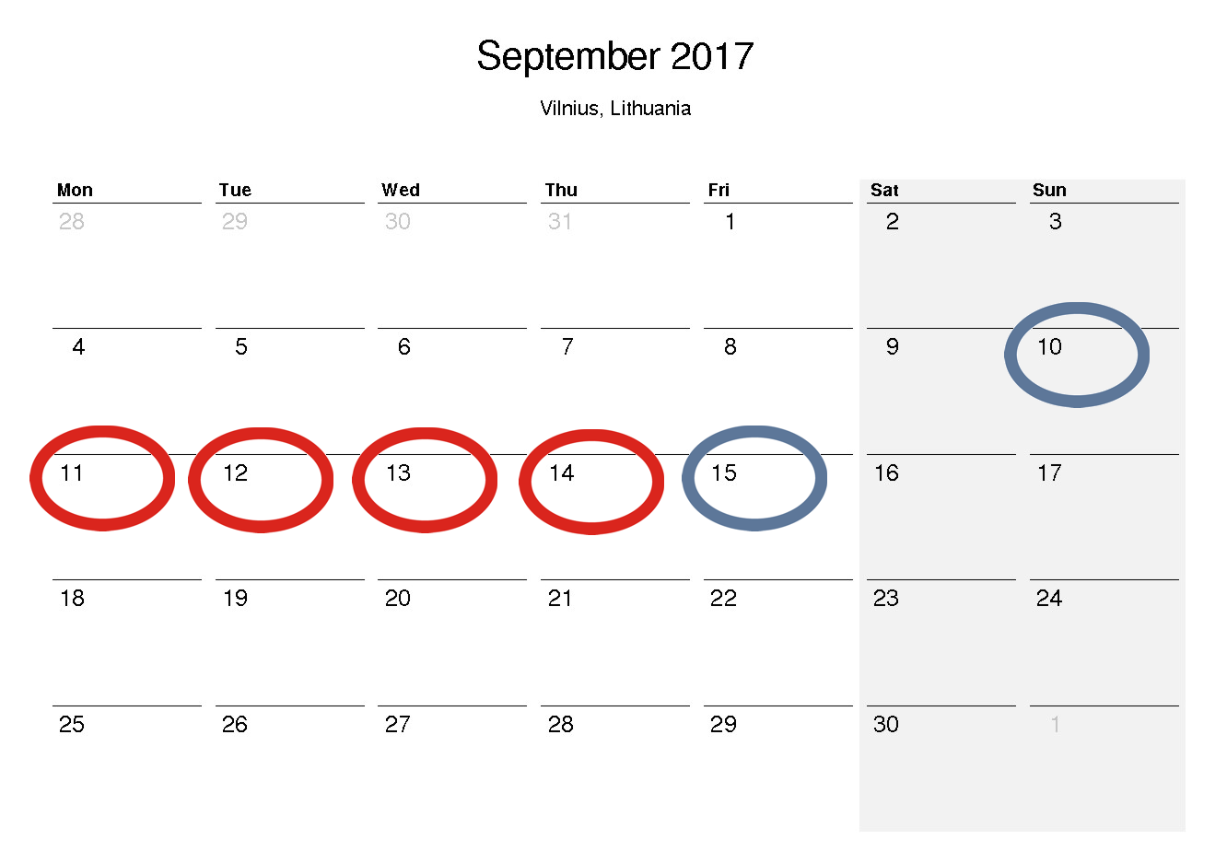
The Dates
Sunday, 10 September
Arrival (long-distance countries)
Monday, 11 September
Arrival (short-distance countries)
Meetings in the framework of regional and linguistic groups
Meeting of the Bureau of the World Conference
Tuesday, 12 September
Congress
General Assembly for the members of the World Conference
Wednesday, 13 September
Congress (continued)
Thursday, 14 September
Social Programme
Friday, 15 September
Departure

Slide 17
The Logo
The logo symbolises the close cooperation of constitutional jurisdiction institutions seeking to share valuable experience gained while implementing constitutional justice – the main guarantee of democracy, the protection of human rights, and the rule of law.
Main elements:
the Constitution (in the colours of the Lithuanian flag)
the globe
the human figure

Slide 18
Concept paper and questionnaires have been sent out. Replies awaited by the end of November (French or English)
Groups invited to propose speakers by end of Sept. 2016
7 official languages WCCJ (Arabic, English, French, German, Portuguese, Russian, Spanish)
The session chairs, rapporteurs, and keynote speakers may use any of these languages for their presentations
Interventions - up to 5 min

Slide 19
The role of session chairs will be to moderate discussions.
The rapporteurs will be invited to take notes during the sessions and to report on the results of the discussions that took place in the respective sessions to the closing session.
The keynote speakers will be invited to present a synthesis (25 minutes maximum) on the members’ replies to the questionnaire at the beginning of each session.

Slide 20
The CC of LT will cover:
Room hire (conference rooms)
Meals
Social programme
One participant from Member Courts from LDCs
Secretariat office, etc.
The Member Courts will cover:
Travel
Hotel expenses
The budget of WCCJ will cover:
interpretation; interpretation equipment, participation of 2nd delegation member from Member Courts from LDCs.

Slide 21
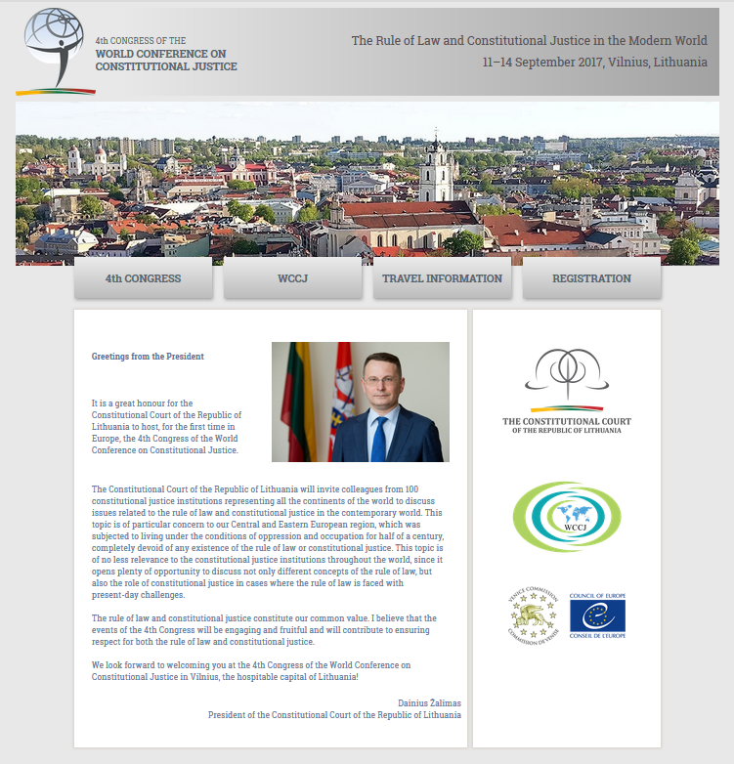
The Website
http://www.wccj2017.lt/
A special website has been created to provide all relevant and updated information concerning the forthcoming 4th Congress.

Slide 22
Invitations:
October-November
Next Bureau meeting:
11 March 2017

Slide 23
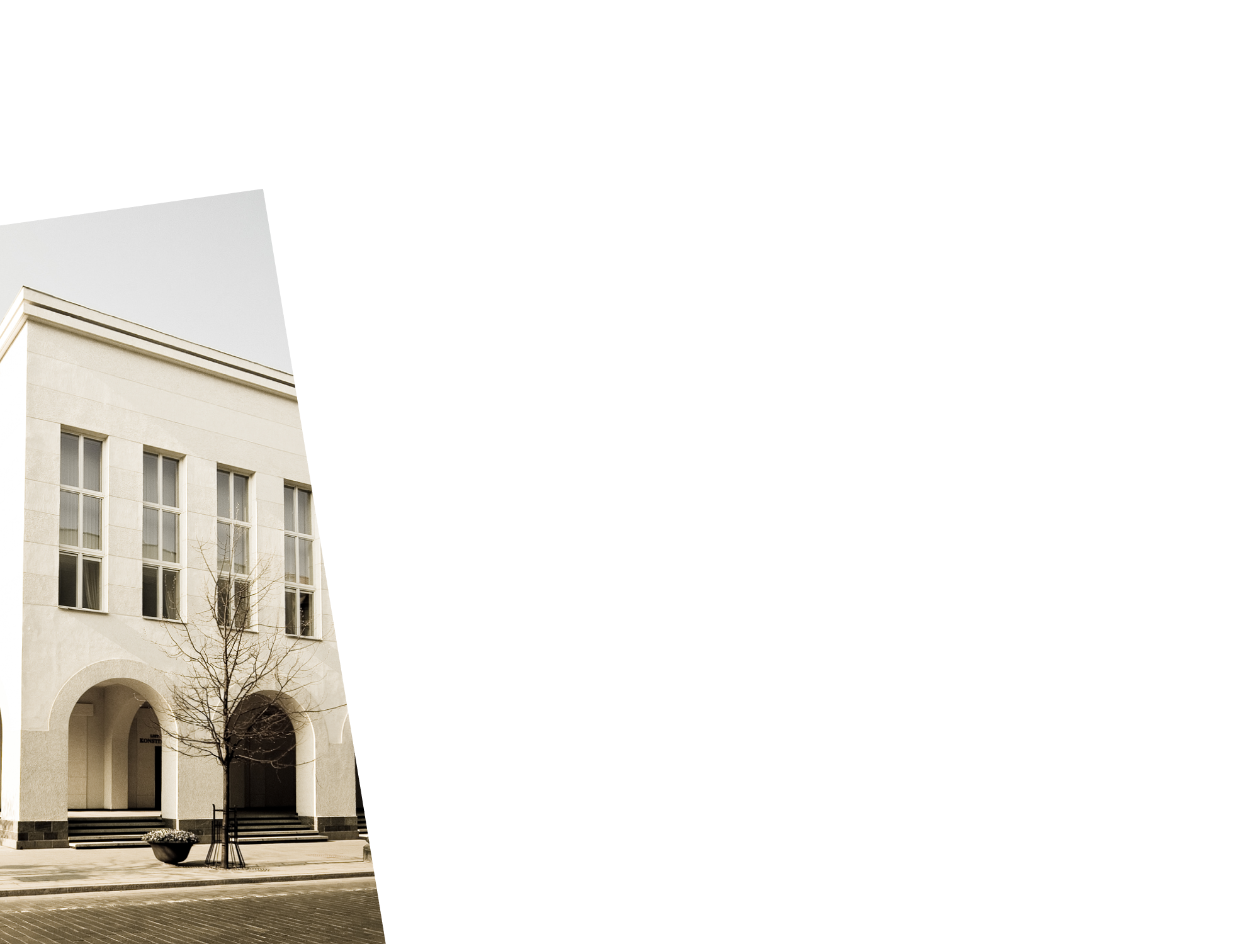
Contacts
We look forward to welcoming you at the 4th Congress of the World Conference on Constitutional Justice in Vilnius, the friendly capital of Lithuania!
Website: www.wccj2017.lt
Contact e-mail: wccj2017@lrkt.lt

